Slide 1
ICT market in Serbia - trends and perspectives
Belgrade, April 26

Slide 2
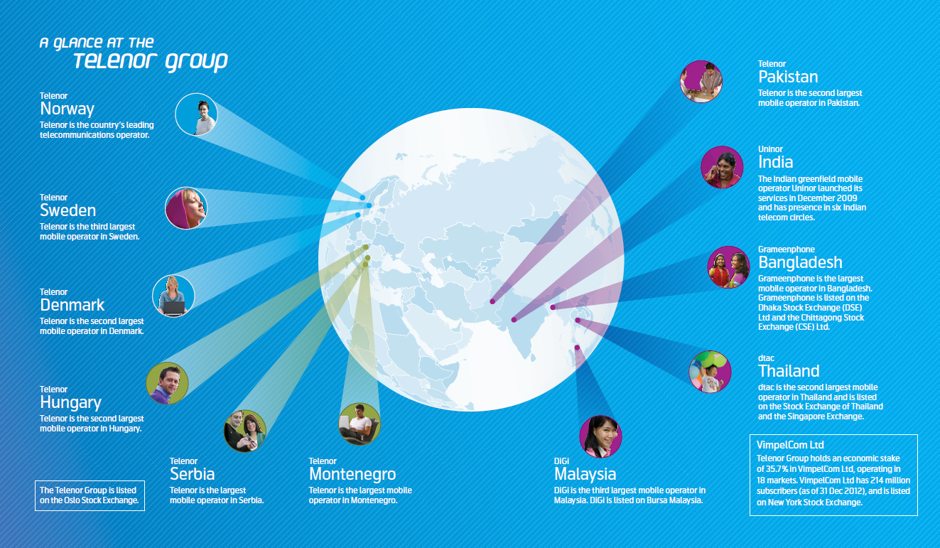


Telenor Group global footprint.
Telenor
Bulgaria
The second largest
Mobile operator in Bulgaria
Telenor
Myanmar
The new member of Telenor Group family

Slide 3

VISION | EMPOWER SOCIETIES
We provide the power of digital communication, enabling everyone to improve their lives, build societies and secure a better future for all.
MISSION | WE’RE HERE TO HELP
OUR CUSTOMERS
We exist to help our customers get the full benefit of being connected. Our success is measured by how passionately they promote us.

Slide 4

Telenor Strategy.
Securing growth
as the customers’ favourite partner
in digital life

Slide 5









Main industry trends.
Trends
mobile
Smartphones
Service bundling
Voice to data transition
Pre to postpaid migration
High-speed Internet everywhere
Data traffic explosion
Connected devices
Mobile broadband
OTT players
Social networks
Networks evolution
WiFi widespread
internet
neworks

Slide 6











High speed Internet everywhere will shift consumer behaviour.
Trends
Mbps
1000
Multi-room
4k/8k TV
100
Point-to-MP
telepresence
Multi-room 3D/HDTV
All data and
content online
Video conferencing
Remote
computing
Low latency for online gaming
Surveillance
10
Home office
Killer
aplication
Voice
Internet
TV

Slide 7
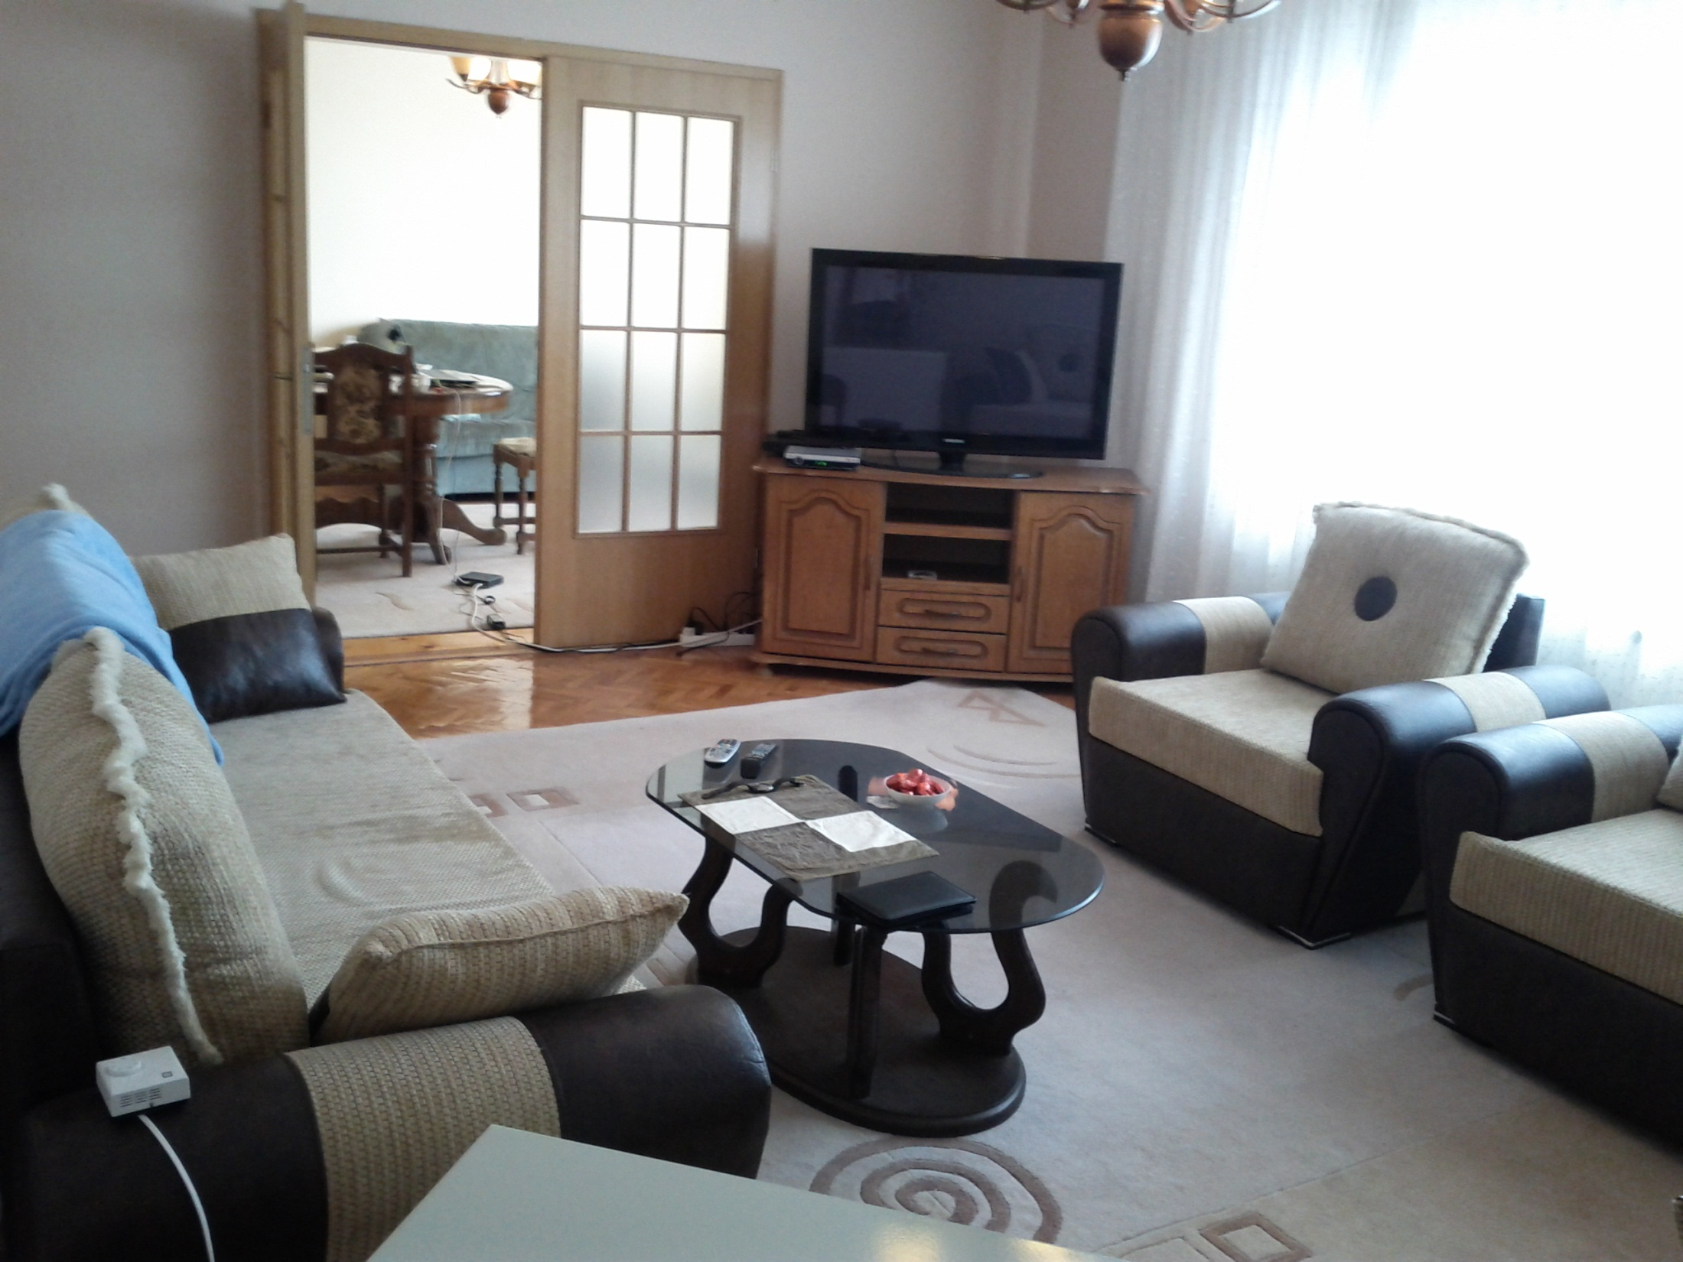

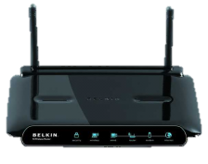
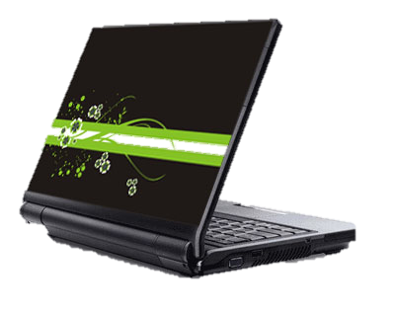
Future household in Serbia
The increasingly connected Serbian household.
3070%
70%
of all data traffic will take place indoor
(desktops, laptops, smartphones, tablets), consumer electronics
Of HHs will have private WiFi
8290%
of households will have mobile phone, of which ~30%
will have WiFi enabled SMARTHPHONES
1060%
of all connected HHs will use WiFi for accessing Internet via laptops, tablets, smartphones
5570%
of households will have fixed Internet access
<15%45% of consumer eletronics will be connected
2016
2020
*2016 to 2020 development

Slide 8
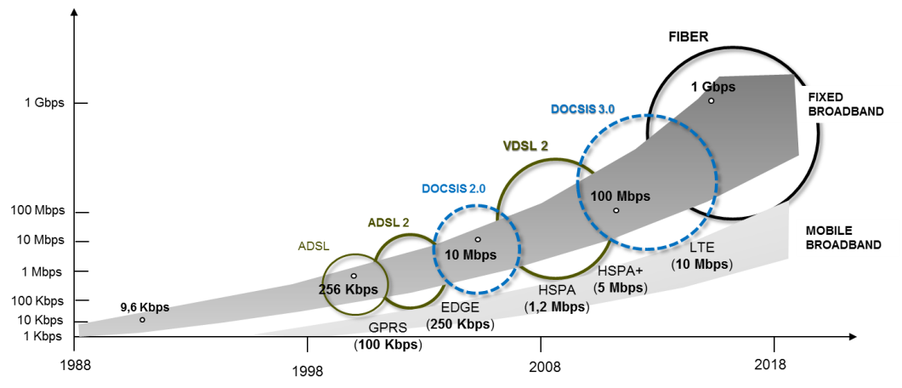
Networks evolution: more, higher, faster, everywhere.
Trends
Balloon powered Internet
Satellite internet
5G

Slide 9





Snapshot of ICT market in Serbia. Key players & RMS.
ICT market
Yearly turnover,
RSD bn
94
36
17
11
22%
25%
Other
35%
2nd
35%
25%
10%
98%
50%
55%
Leader
43%
Rev. Market
shares
Mobile
Fixed
Internet
Pay TV
¹Calculated ICT shares other than mobile are indicative, due to lack of valid data

Slide 10

Telenor Wholesale Service
CONNECTIVITY SERVICES
FIXED SERVICE
TELEHOUSING SERVICES
IP SERVICES

Slide 11
Telenor Wholesale Service
FIXED SERVICE
Telenor
Cable Operator
Split of responsibilities
    Provide connectivity with all National and International operators
    Provide proper Billing and CDRs
    Provide Fraud protection
    Provide environment for Customer Management
    Provide environment for Fixed Number Portability
    Fulfill legislation requirements (Lawful Interception, Data retention)
    Registered by RATEL as a Fixed Operator
    Owns contract with Customers
    Owns assigned Fixed Numbering Ranges
    Invest in CPE equipment and Customer Acquisition
    Customer Care and Customer management

Slide 12

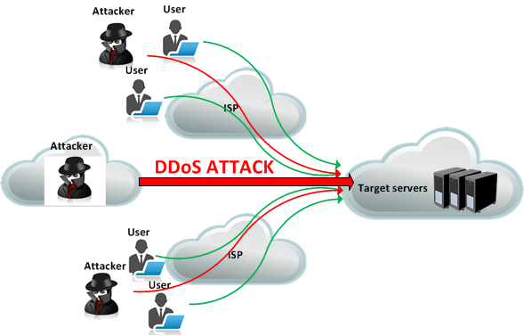
Telenor Wholesale Service
IP SERVICES
DDoS
IP Transit service :
  All PoPs in Europe (direct access)
  Flexible billing models – Flat rate or usage based (burst-billing)
  BGP dynamic routing with the following options:
  IPv6 Native / Dual stack
  DNS primary and secondary services
Interfaces:
SLA specifications:
Network Operations & Customer Support: 24/7
DDoS attacks facts:
Telenor can compete to largest carriers offers with own robust systems of dynamic mitigation and detection of DDoS attacks

Slide 13
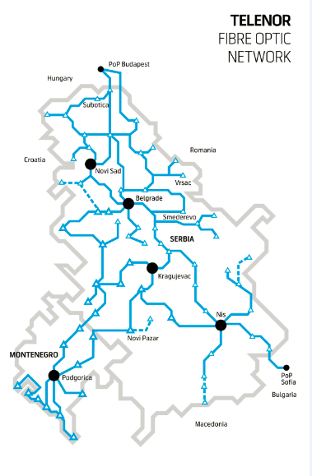
Telenor Wholesale Service
CONNECTIVITY
~ 6500 km of fibre optic network in Serbia, Montenegro Hungary and Bulgaria
The best IP radio networks in Serbia and Montenegro, covering 98% of whole Serbian teritory
Multiple Cross-border links with Hungary, Croatia, Romania, Albania, Bulgaria and Montenegro
Extensive metro networks carring voice, data, IP/MPLS and broadband services
High level of Quality of Service is secured by MPLS traffic engineering allowing the guaranty of traffic throughput and route availabilty

Slide 14
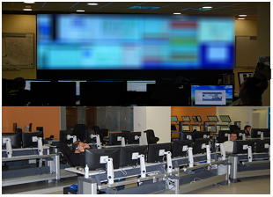
Telenor Fixed Wholesale Service
Connectivity services
Dark fibre
Telenor Serbia and Montenegro fibre network connects the countries of the Balkans region, via several rings, allowing resilient traffic routing
Wavelength
Telenor Serbia and Montenegro main international PoPs in Belgrade, Budapest and Sofia are connected via our wavelength network.
SDH capacities
Private leased line options from E1 to STM-64 across Telenor Serbia fibre optic network
Ethernet solutions
Service are delivered via Layer 2 platform for purpose of provisioning of end-to-end connections with SLA secured by MPLS traffic engineering
Completely redundant networking equipment with dual power supplies and spare units for all critical equipment
Ethernet services available across entire network footprint with connectivity ranging from 2Mbps/s to 10Gb/s
Telenor’s Common Network Operation Center (CNOC) provides 24/7 proactive monitoring of whole network with continuous follow-up of network performances

Slide 15
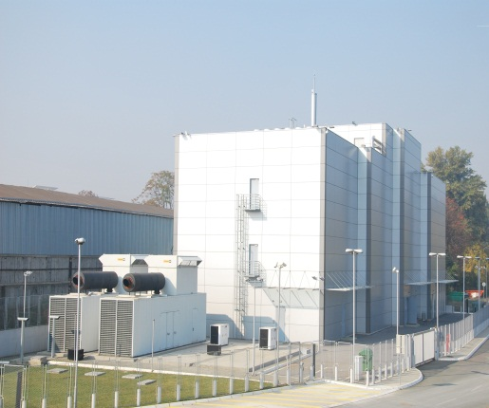
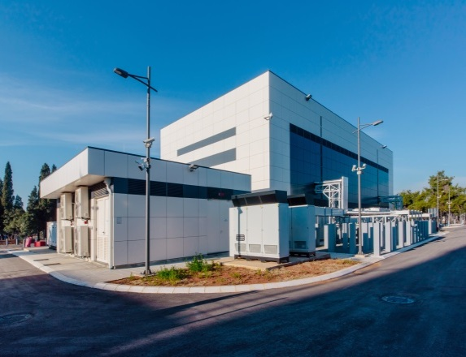
Telenor Wholesale Service
Telehousing services
Built in 2009 in Belgrade with 2600 m²
in 2015 in Podgorica with 780 m²
as separate stand alone facilityies with full at least N+1 redundancy on all mechanical, electrical and connectivity infrastructure
Belgrade
One of the most advanced Data Centers in SEE region
Service features :
42U cabinet (rack) and/or footprint
Customized solutions- Cage/separated data room
Video surveillance of each cabinet
ISO 27001 certified
Web portal with real-time monitoring of service parameters such as: power consumption,, video surveillance, ttemperature, hhumidity parameters
Hands & Eyes services
Power supply – SA – 99,9999%
Podgorica

Slide 16
Thank you

